Slide 1
CS 4530: Fundamentals of Software Engineering Lesson 6.1 UI Design / User-Centered Design
Jonathan Bell, Adeel Bhutta, Ferdinand Vesely, Mitch Wand
Khoury College of Computer Sciences
© 2021 Released under the CC BY-SA license

Slide 2
Learning Objectives for this Lesson
By the end of this lesson, you should be able to:
Describe the major aspects of usability;
Articulate the process of user-centered design;
Explain several heuristics for good user interaction.

Slide 3
Goal: Build the Right Product
If the product doesn’t do what the users want…
… we’ve wasted time and money.
If the product is not usable by the users…
… we will need to invest time/money to make it usable.
Users are often not sure exactly what they want,
… so we iterate the requirements process.
We shift development “to the left” (closer to user)
We correct mistakes
Before design, or else
Before coding, or else
Before debugging, or else
Before deployment.
The earlier,
The better!

Slide 4
UI Design is important part of the link between user and technology
Software Design includes a lot more than just designing components and architecture
Important to design:
User Interfaces
Contents
Navigation
We want “Usable” software

Slide 5
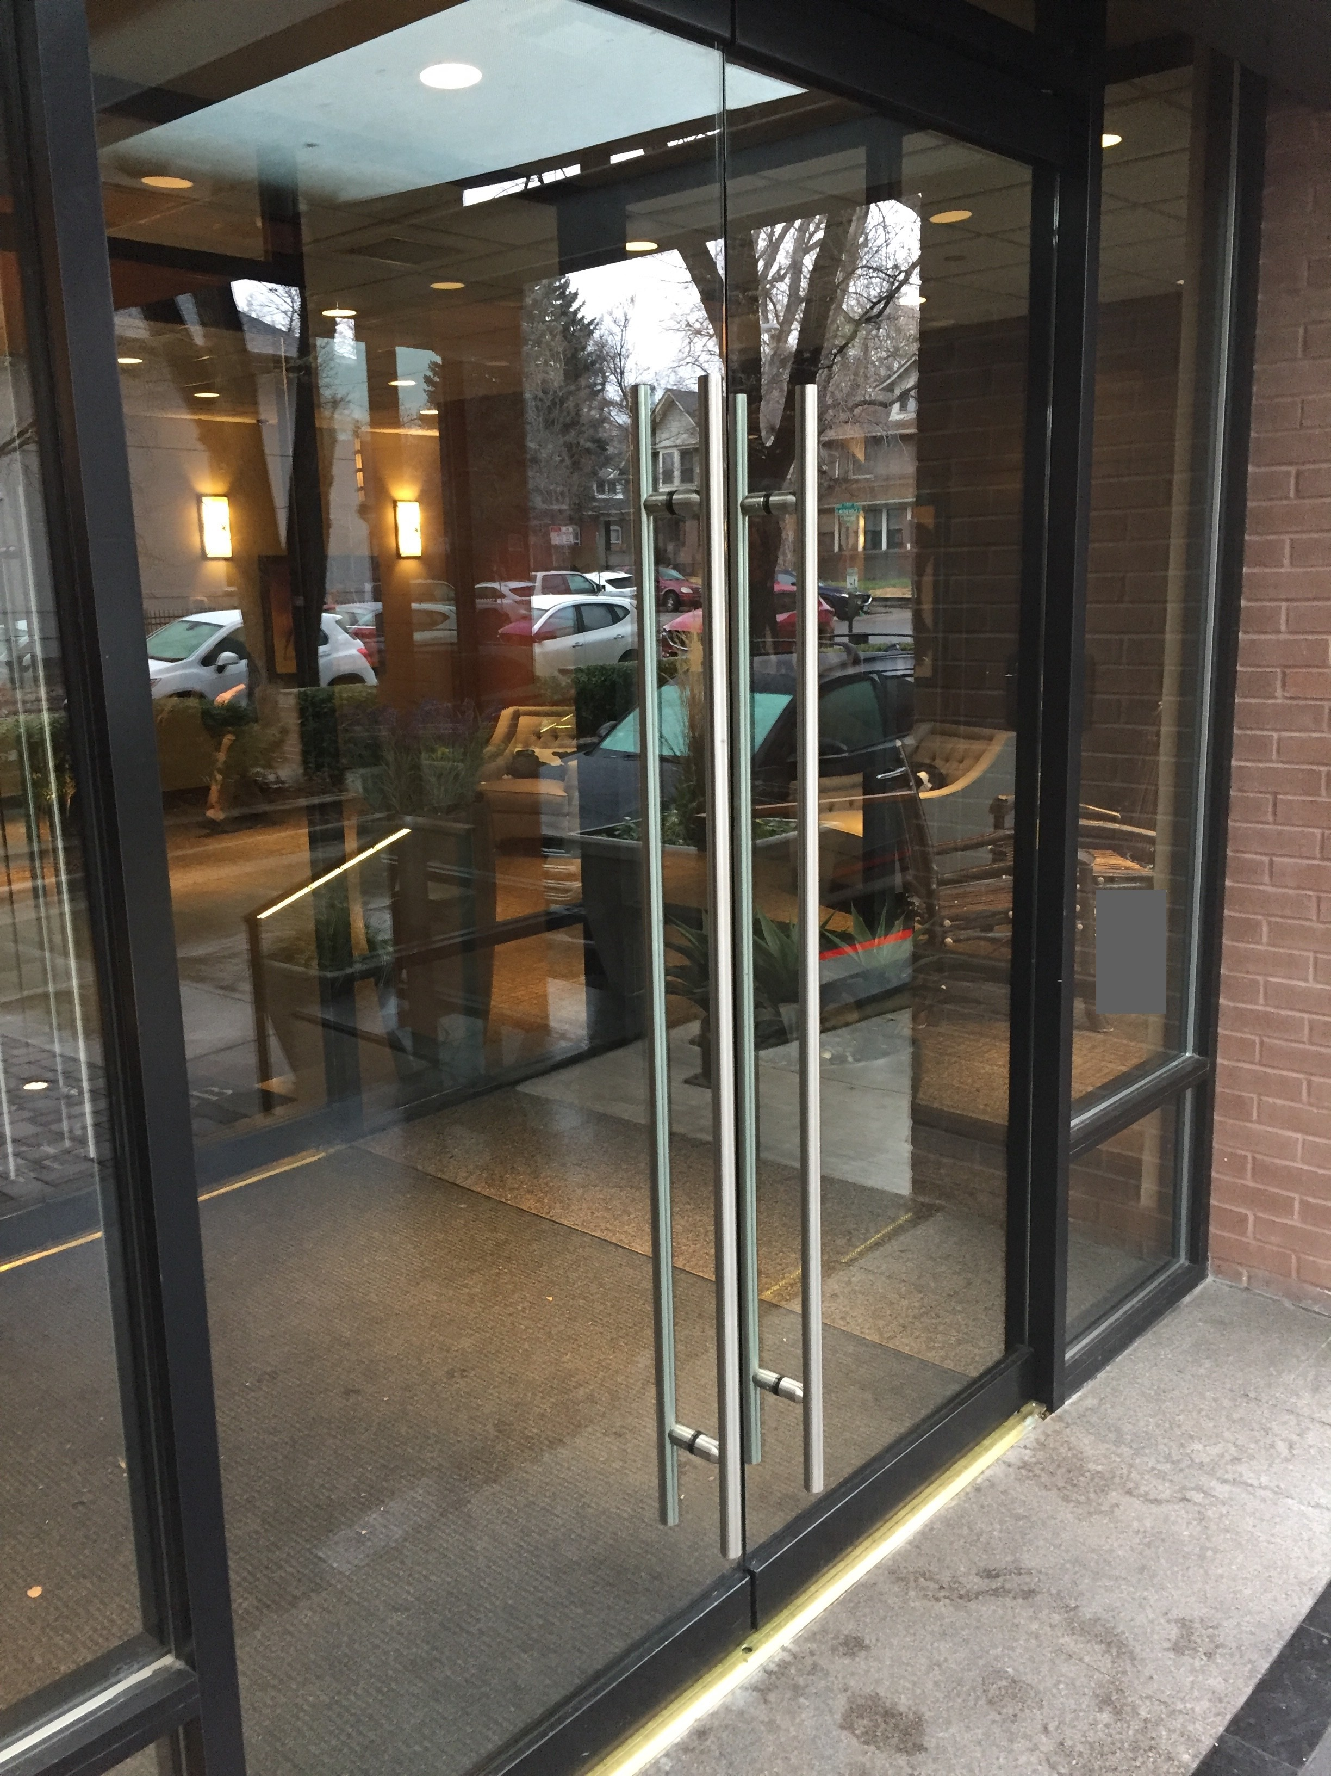
Usable or Unusable?

Slide 6
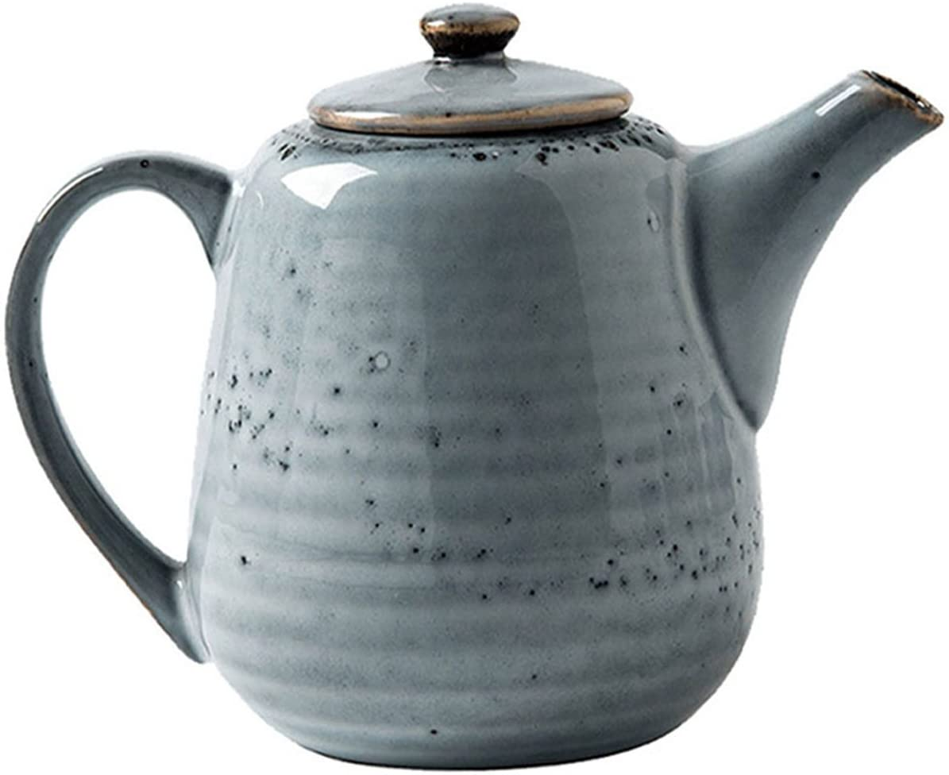
Usable or Unusable?
From Don Norman, Psychology of Everyday Things (c 1988)

Slide 7
“Usability”: a Definition
Usability is …
… a measure of how …
… an artifact …
... impacts …
… a human …
… with particular goals.
For us:
a software artifact
The goals are key!
7

Slide 8

Usability Characteristics (1 of 5): Learnability
How easy is it to learn to use the artifact to accomplish a goal?
A “steep” learning curve requires a lot of expertise before one can achieve results.
Expertise
Result

Slide 9

Usability Characteristics (2 of 5): Effectiveness
How often does the use lead to completion of a goal?
Is the artifact “fit for purpose”?

Slide 10
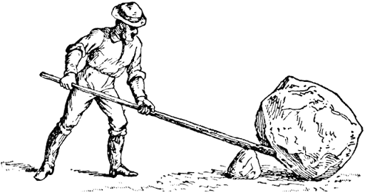
Usability Characteristics (3 of 5): Productivity
How large a multiplier of human effort does this artifact give?
Does it make hard things easy? (or the reverse!)

Slide 11
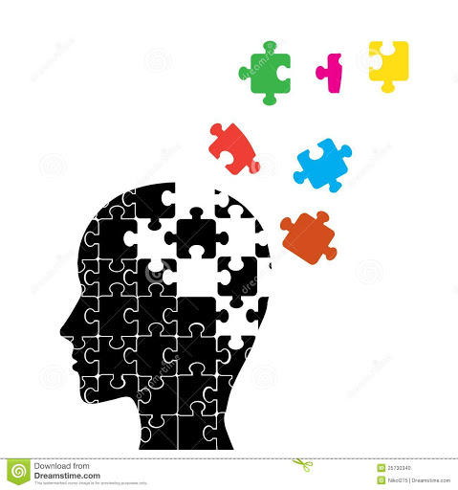
Usability Characteristics (4 of 5): Retainability
How long is the ability to use the artifact retained between uses?
Inner consistency can help mitigate a steep learning curve.

Slide 12
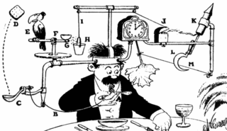
Usability Characteristics (5 of 5): Satisfiability
How pleasant is the artifact to use?
Is it elegant and simple?

Slide 13
Why study Usability?
It is crucial for user satisfaction
Adapted from Maneesh Agrawala & Bjoern Hartmann
Crash of AA Flight 965
Airbus A350 Cupholders
http://en.wikipedia.org/wiki/American_Airlines_Flight_965

Slide 14
“Usability
Not…
“dummy proofing”
being “user-friendly”
making software pretty
Usability IS:
Recognize: “The user may not be like me”
Understanding user needs, tasks, goals
User’s mental model matches with designer’s mental model
14

Slide 15
User-Centered Design
A system is evaluated from the user viewpoint.
Ideally by the users!
Tension: when do we evaluate?
An incomplete product may not be usable;
If a product is complete, using evaluation has cost.
Resolution: evaluate prototype!
Evaluate
Requirements
Develop
Prototype

Slide 16
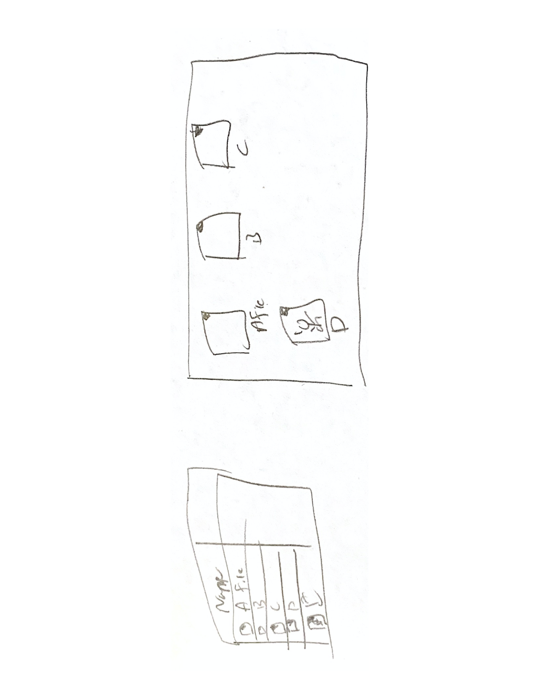
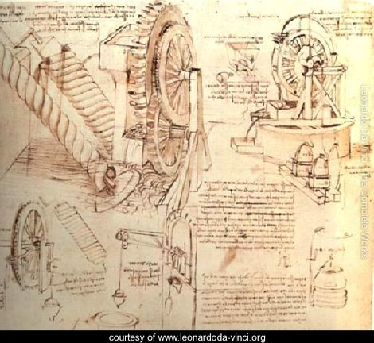
Key Idea: Design Alternatives
Use sketches

Slide 17
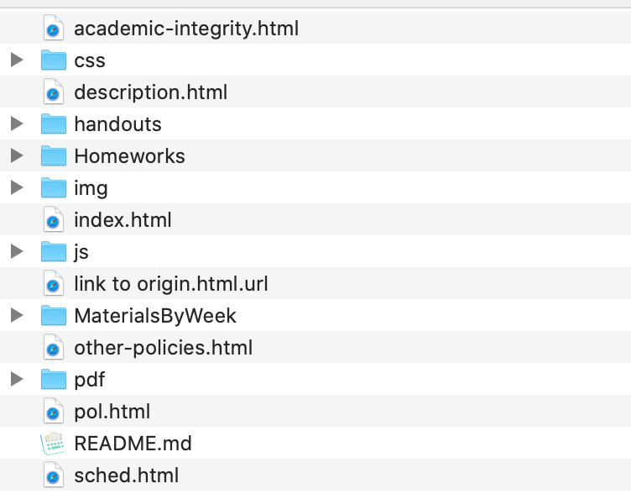
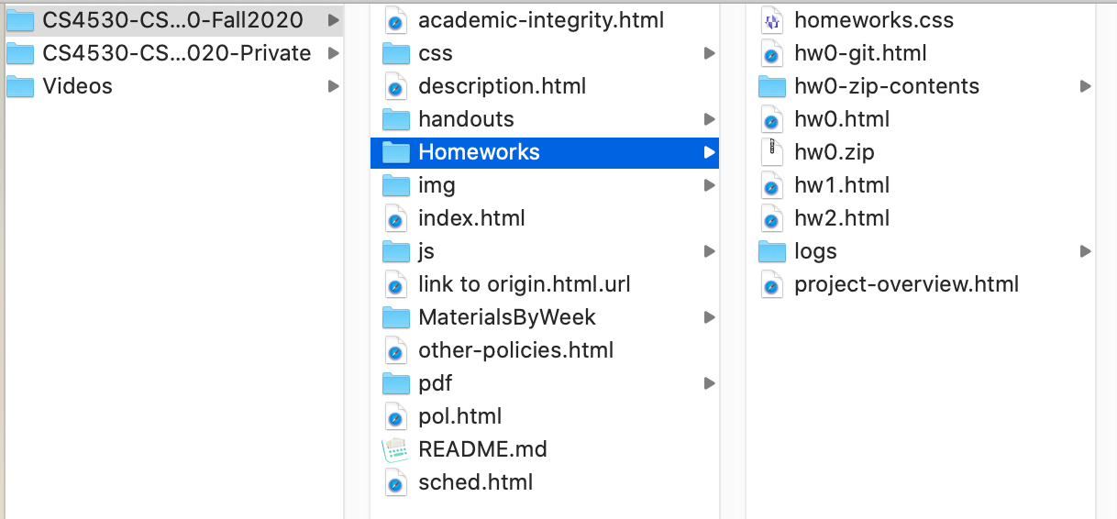
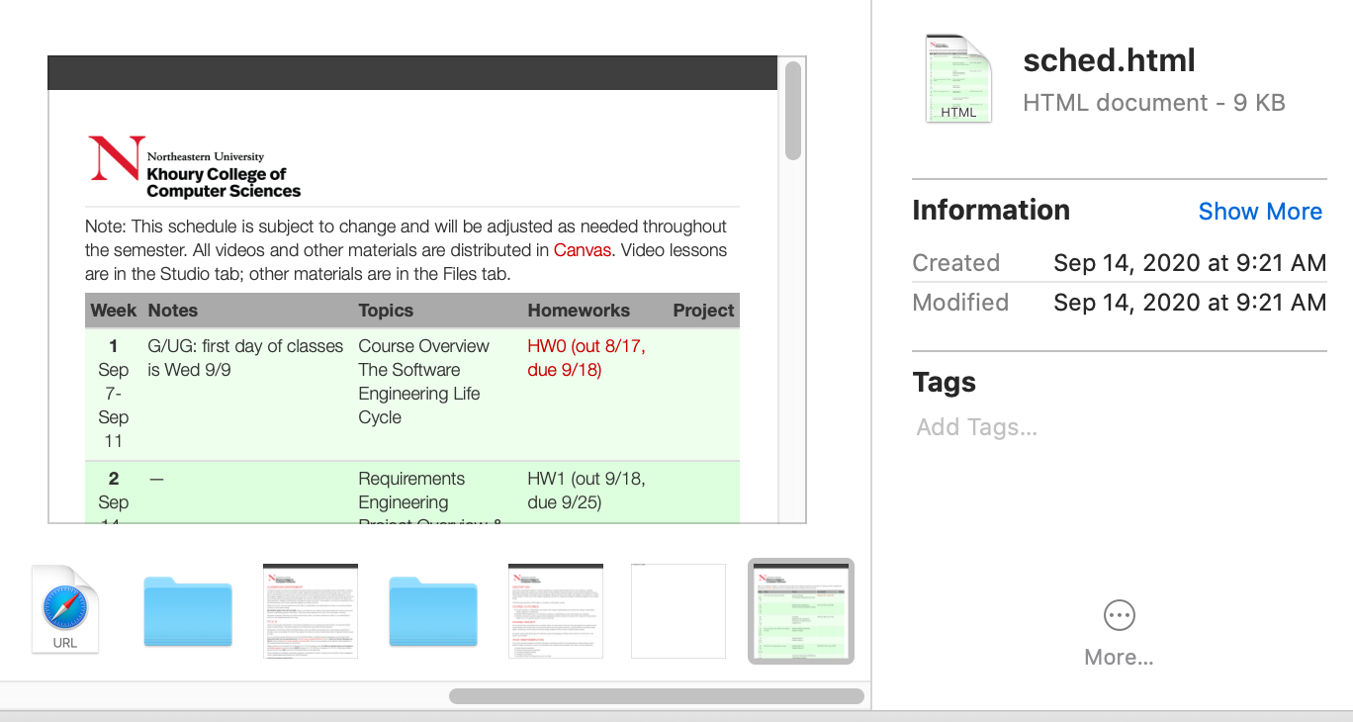
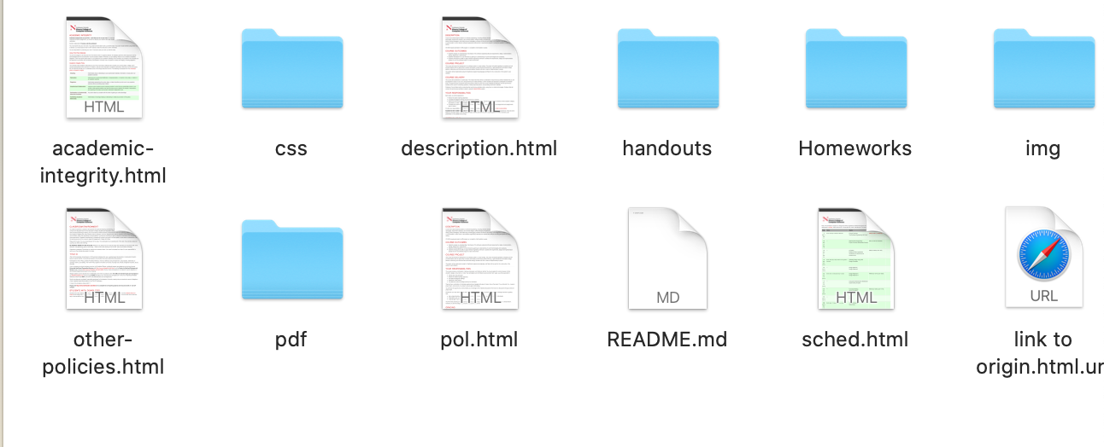
Key Idea: Design Alternatives
Think broadly with wide range of possible designs then choose “one”

Slide 18
Prototype (1 of 3): Paper Simulation
Hand-drawn user interfaces:
on paper or card;
made on the spot.
Developers animate:
Present to test user;
Users act:
Indicate what they would do.
Advantage: fast turnaround, cost less, allow more iterations

Slide 19
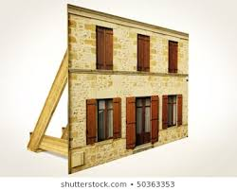
Prototype (2 of 3): Wizard-of-Oz
Software has right “look”
But barely functional.
Scripted interaction only
All responses are “canned.”
Illusion is effective.

Slide 20
Prototype (3 of 3): Working Prototype
The software system partly implemented:
User interface fully realized;
Functionality limited.
Particularly for feature requests:
New feature can get quick-and-dirty implementation
Quickly get feedback if the right feature is implemented.
Comparison of UCD with TDD:
In TDD: feature request is realized in a test;
In UCD: feature request is realized in a user-interface.
In both cases, we delay implementation
until more understanding gained:
Move decisions closer to customers.

Slide 21
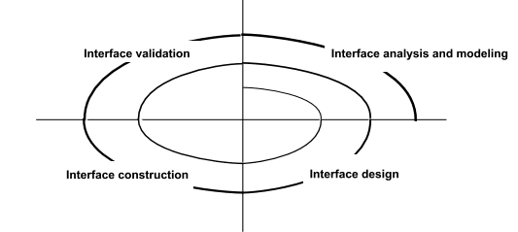
User-Centered Design is refined
Are requirements fully understood ?

Slide 22
Tips for Aesthetic Design (UI Design)
Don’t be afraid of white space.
Emphasize content that meets user needs.
Organize layout elements from top-left to bottom right.
Group navigation, content, and function geographically within the page/screen.
Don’t extend your real estate with the scrolling bar.
Consider resolution and browser window size when designing layout.
https://blog.prototypr.io/ux-design-101-prototyping-rapidly-sketching-wireframes-65b7dfbabf52

Slide 23
Forms of User Evaluation
Empirical evaluation study
“How many tasks accomplished in N minutes?”
Qualitative evaluation
Observers find patterns in interaction;
Users give feedback after use.
”Dogfooding” (internal evaluation)
Developers use product as soon as feasible.
Heuristic evaluation
Evaluate against best practices.

Slide 24
Best Practice Heuristics (Nielsen)
“Discount ($) usability engineering methods”
Pioneered by Jakob Nielsen in the 1990s
Involves a small team of evaluators to evaluate an interface based on recognized usability principles
Heuristics–”rules of thumb”
Much cheaper than an
evaluation With ”real” users!
(Adapted from slides by Bonnie John and Jennifer Mankoff)

Slide 25
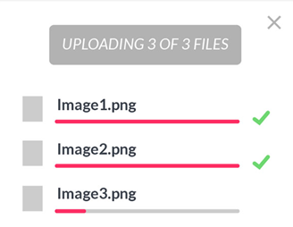
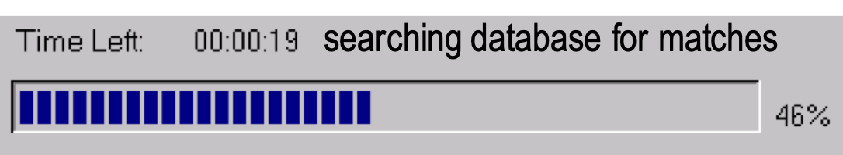
H1: Visibility of System Status
Interface should show:
What input has been received;
What processing is currently happening;
What results have already been completed.
This feedback allows
user to monitor progress towards solution of their task;
allows the closure of tasks; and
reduces user anxiety (Lavery et al).
Great podcast with interview with Brad Myers, creator/popularizer of progress bar in his 1985 PhD thesis (99 Percent Invisible 9/3/19)

Slide 26
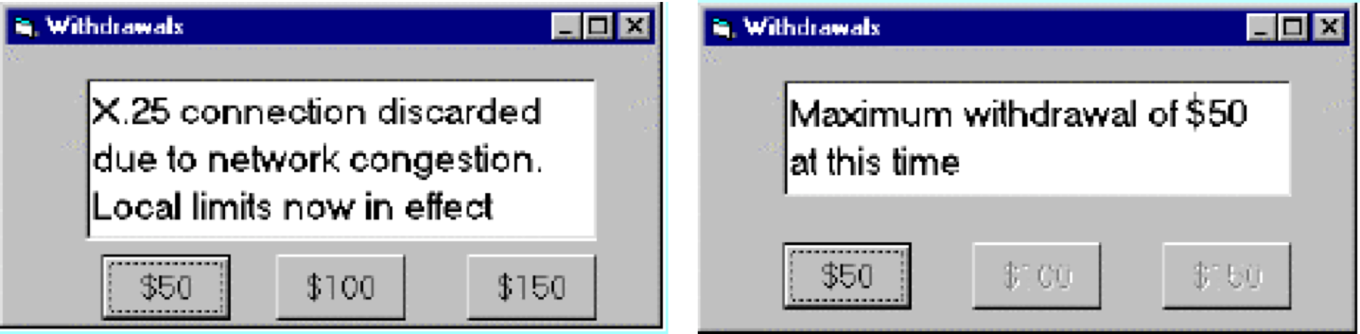
H2: Match Between System and Real World
Speak the users’ language.
Follow real world conventions.
Don’t use internal jargon (“X.25 connection discarded”)
“Gray out” illegal options.

Slide 27
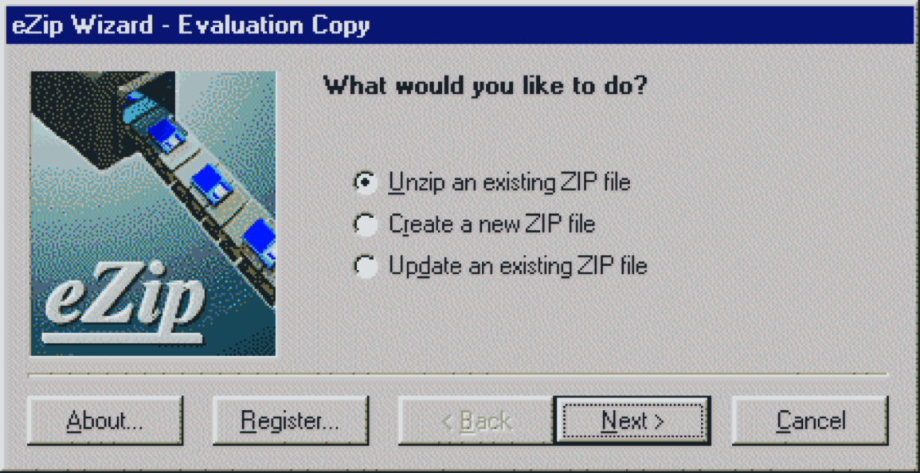
H3: User Control and Freedom
“Exits” for mistaken choices: undo, redo, cancel
Don’t force down fixed paths.

Slide 28
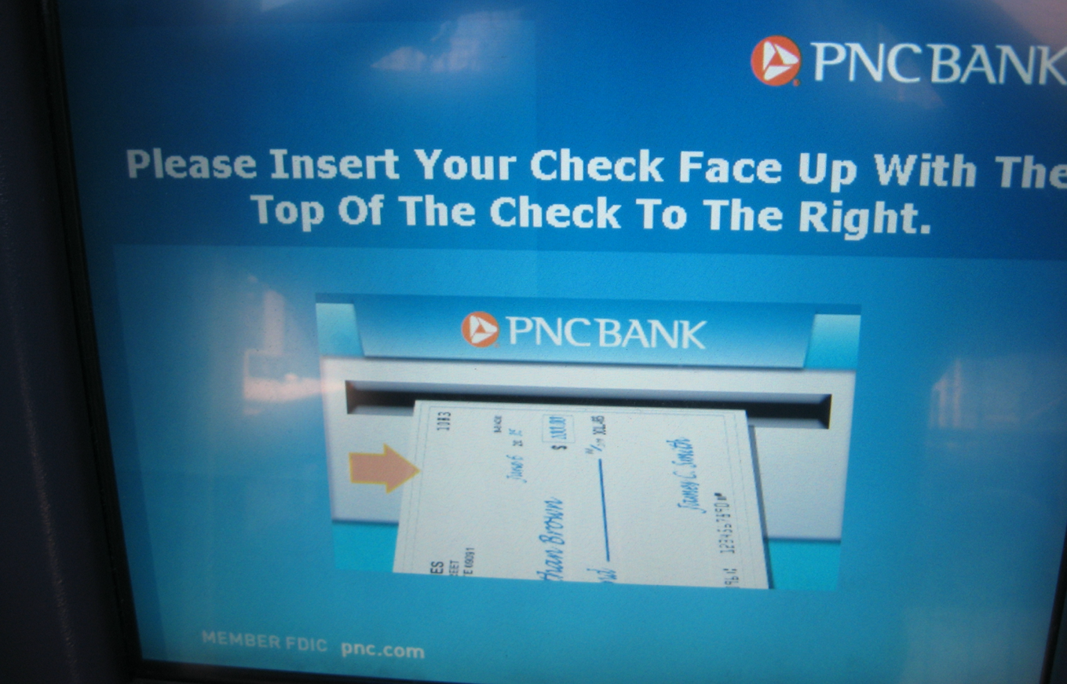
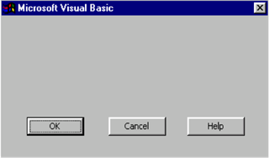
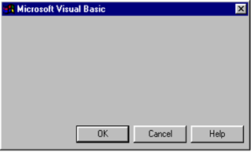
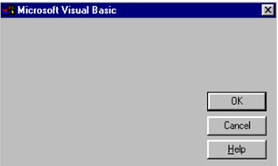
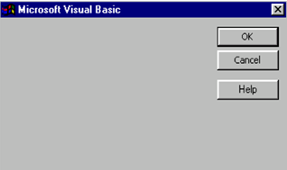
H4: Consistency and Standards
Same words, situations, actions, should mean the same thing in similar situations;
Same things look the same and be located in the same place.
Text consistent with figures.
Different things should be different.

Slide 29
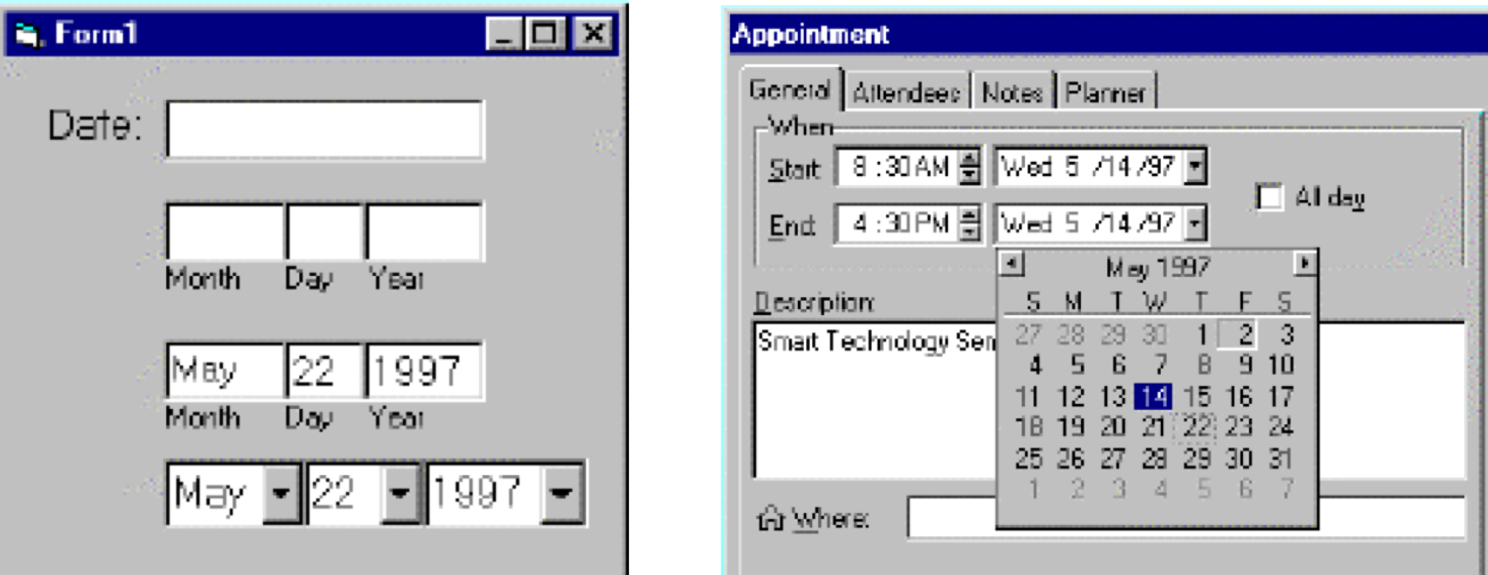
H5: Error Prevention
Careful design can prevent a problem from occurring in the first place.
It’s easier to point to a date on the calendar than to type it in the correct format.

Slide 30
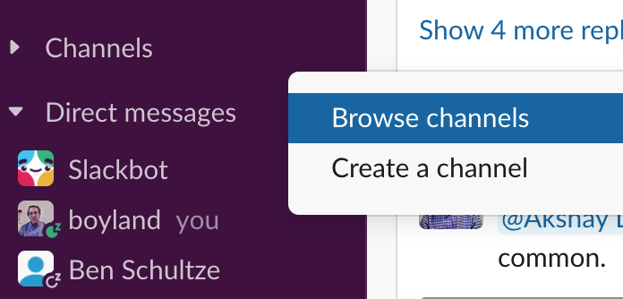
H6: Recognition rather than Recall
Make objects, actions and options visible or easily retrievable.
It’s easier to pick out the channel we want to add than to enter the correct name.

Slide 31
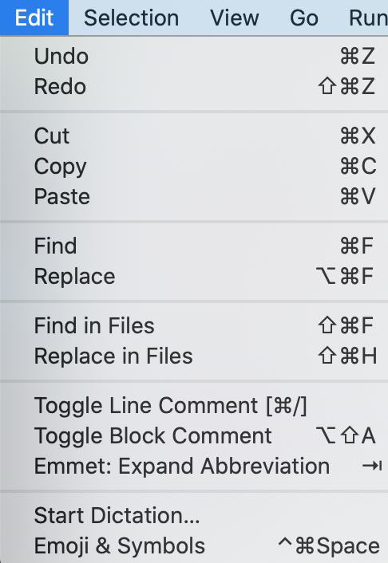
H7: Flexibility and Efficiency of Use
Accelerators for experts (e.g., gestures, kb shortcuts)
Allow users to tailor frequent actions (e.g., macros)

Slide 32
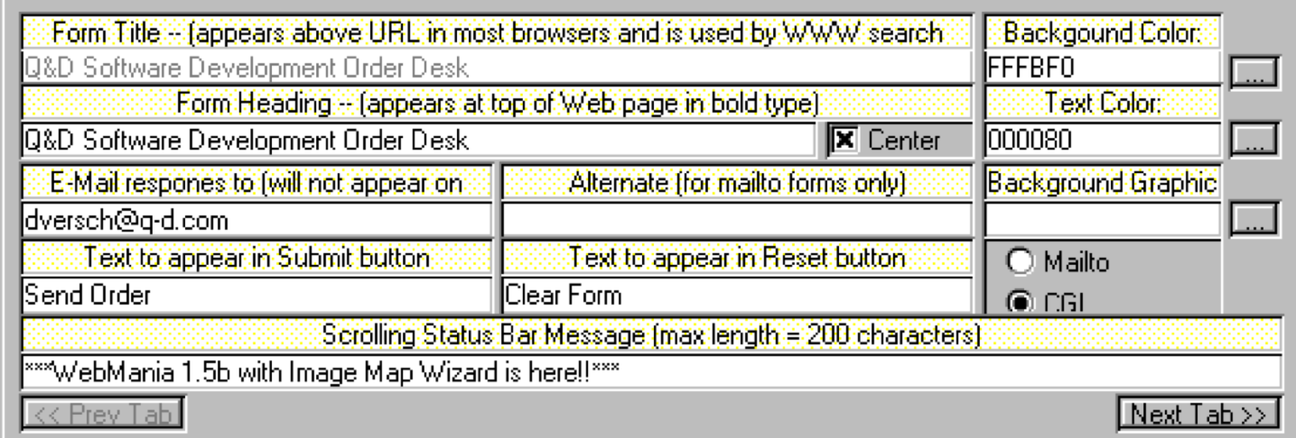
H8: Aesthetic and Minimalist Design
Interfaces should not contain irrelevant or rarely needed information.

Slide 33
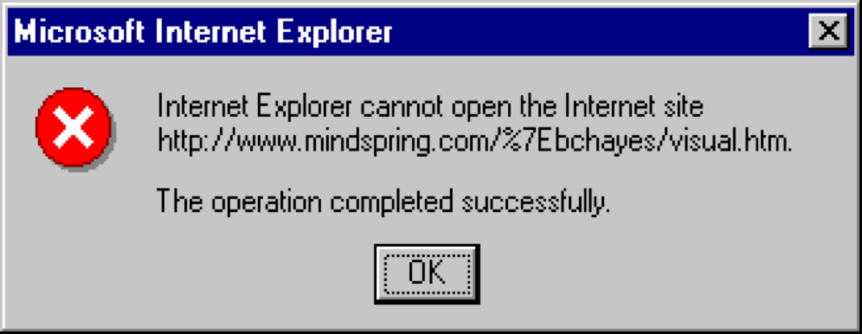
H9: Help users recognize, diagnose, and recover from errors
Use standards to convey errors;
Error messages should be in language user will understand;
Precisely indicate the problem;
Constructively suggest a solution.

Slide 34
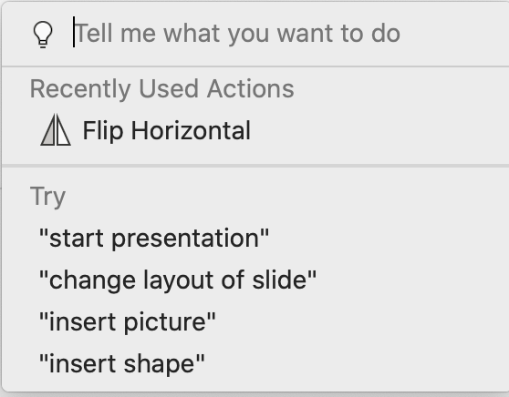
H10: Help and Documentation
Should be
Easy to search;
Focused on the user’s task;
List concrete steps to carry out;
Always available.

Slide 35
Review: Learning Objectives for this Lesson
you should now be able to:
Describe the major aspects of usability;
Articulate the process of user-centered design;
Explain several heuristics for good user interaction.

